Slide 1
USB for All!!1
You should be looking at USB.
Yes, you.

Slide 2
Introduction
Who We Are
Jesse Michael
Mickey Shkatov
What We Do
Break things
Cry about the current level of security research focused on USB
DISCLAIMER: The views and opinions expressed in this presentation are those of the authors and not their employer.

Slide 3

Purpose of this talk

Slide 4
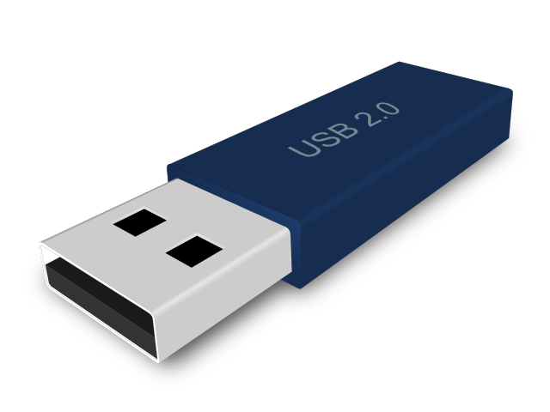

Purpose of this talk
We want to demonstrate to attendees how easy it is to get started at performing their own USB security research and help them understand why they should undertake this challenge.

Slide 5
Why care about USB?
We believe that even though USB is a pervasive technology in modern computing platforms, current security research has still only scratched its surface.
USB has some interesting capabilities and is currently being used in a wide array of lesser-known usage models that can result in security problems.

Slide 6

USB Basics
USB versions
1.0, 1.1, 2.0, 3.0, 3.1
Speeds
Low Speed, Full Speed, High Speed, Super Speed Gen1 and Gen2
Device classes
HID, Mass Storage, Image, Video, Audio, Communications, Vendor Defined
Physical connections
1.x/2.0 standard
Vcc (5V), Data+, Data-, Ground
1.x/2.0 mini/micro
Added USB OTG ID Pin
3.0+
Added SSTx+, SSTx-, SSRx+, SSRx-
Notes:
Several pre-releases of the spec throughout 1994 and 1995.
Official 1.0 spec released in 1996 – 18 years ago. 1.5Mb/s and 12Mb/s
1.1 in 1998 (fixed problems identified in 1.0 – mostly to do with hubs – first widely used), 2.0 in 2000 (480Mb/s signaling rate, 280Mb/s usable data rate), 3.0 in 2008 (5Gb/s signaling, 4Gb/s usable data rate), 3.1 in 2013 (10Gb/s signaling rate)
ID Pin: Host == connected to ground, device == not connected

Slide 7
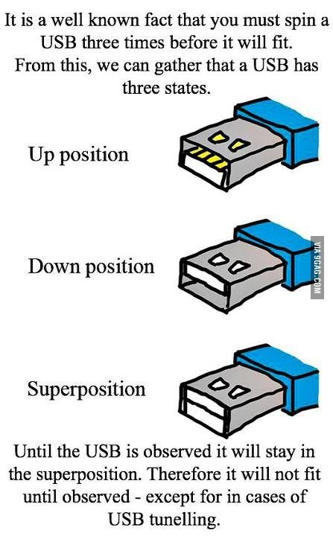
USB Basics

Slide 8
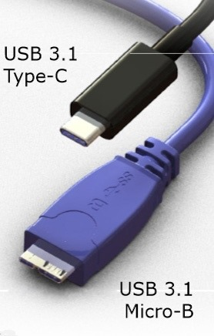
USB Type-C
Reversible!
Supports 10Gbs data rate
4 superspeed differential pairs
Supports 100W power delivery
Notes:
Type-C connector and wire standard finalized and released less than a week after our Defcon talk
24 pins in connector

Slide 9
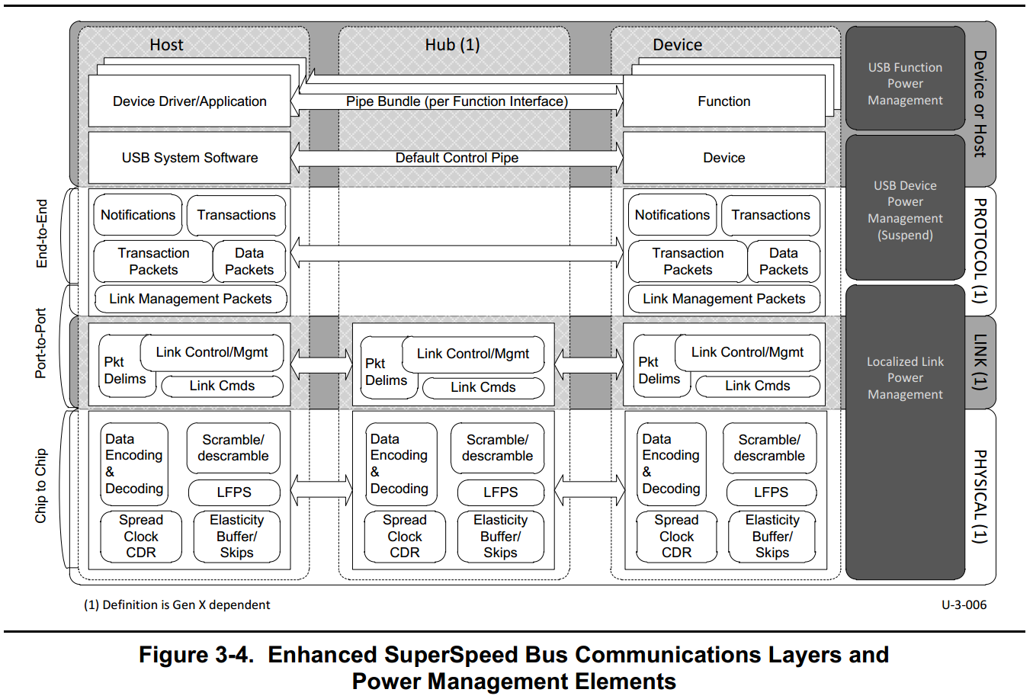
Getting started
http://www.usb.org/developers/docs/
At over 600 pages, the USB specification can be a little intimidating...

Slide 10
Getting started
In most USB devices, the physical, link, and protocol layers are handled in hardware...
Notes:
Certainly possible to find vulnerabilities in the hardware managing these layers, but that’s hard and can require expensive equipment.

Slide 11
Getting started
These areas are the easiest place to get started and find vulnerabilities so we’ll focus here and on some bigger picture views of how USB devices are used in modern platforms.

Slide 12
Device Enumeration
Host doesn’t know what devices are connected to USB ports
General sequence of events—
Determining a device has been connected
Determining device speed
Determining which device is attached
Determining the device configuration
Determining the device interface
Loading the driver
Notes:
http://www.ftdichip.com/Support/Documents/TechnicalNotes/TN_113_Simplified%20Description%20of%20USB%20Device%20Enumeration.pdf
Changes in resistance and electrical characteristics of the lines is used to determine if device has been attached, on-the-go, line speed

Slide 13
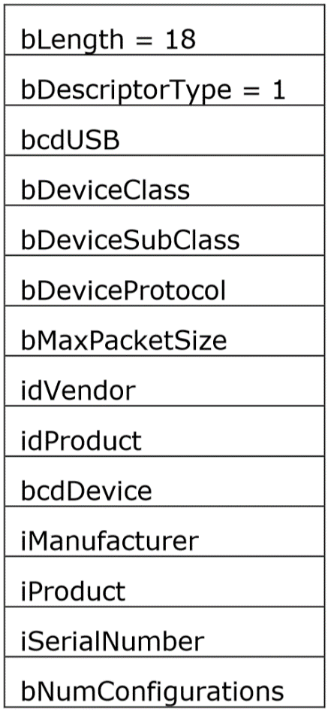
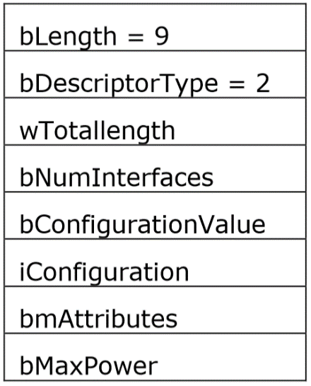
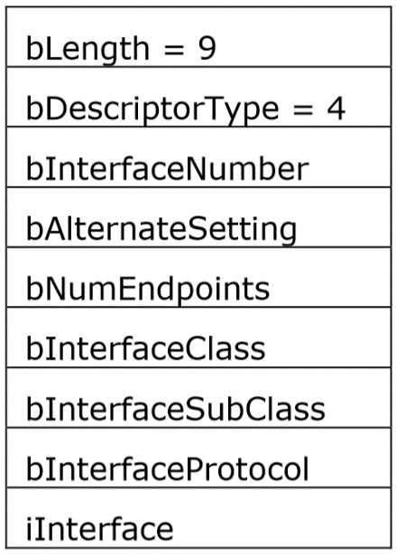
Device Enumeration
Device Descriptor
Configuration Descriptor
Interface Descriptor
All of these values are provided by the device.
Notes:
http://www.ftdichip.com/Support/Documents/TechnicalNotes/TN_113_Simplified%20Description%20of%20USB%20Device%20Enumeration.pdf

Slide 14
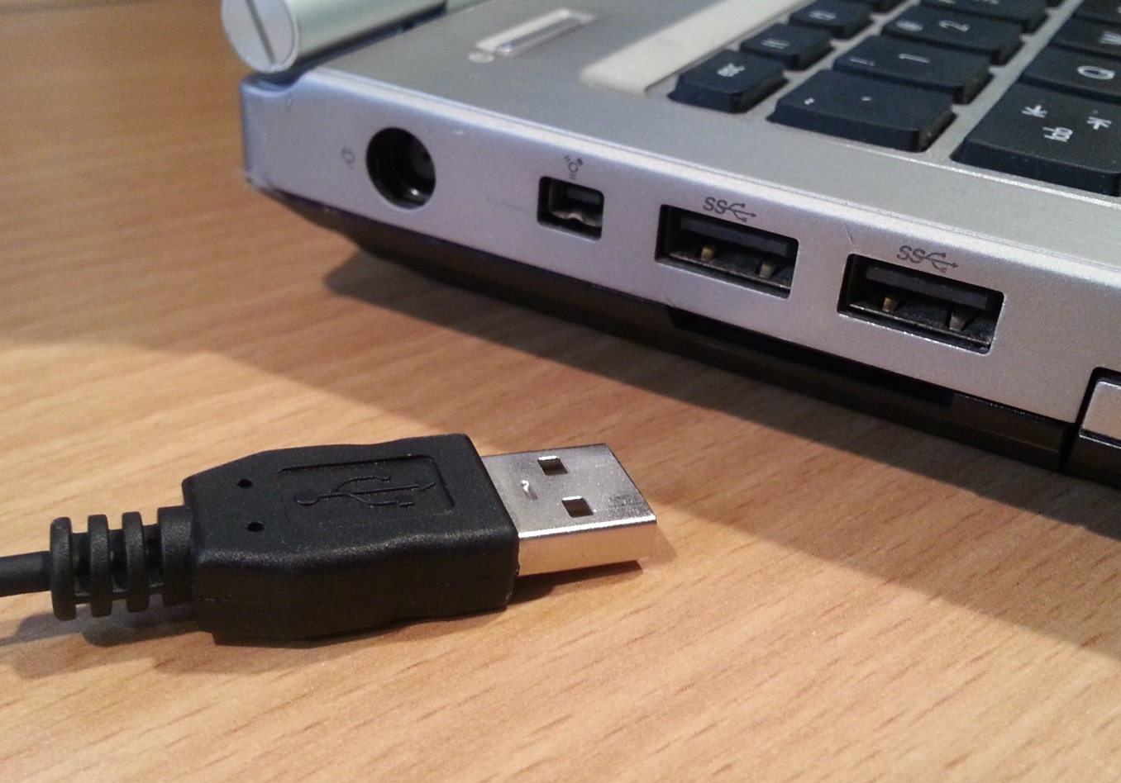
Do I need to touch it?
Most people think about USB like this...
Notes:
BadUSB talk at Blackhat this year by Karsten Nohl and Jakob Lell has people talking about filling usb ports with superglue

Slide 15
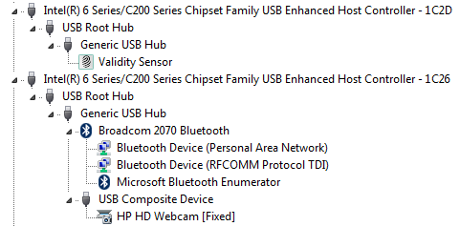
Do I need to touch it?
...but almost all modern laptops have internal USB devices.
Which often contain their own processors with firmware and are separate from the host CPU and operating system.
What could go wrong?

Slide 16
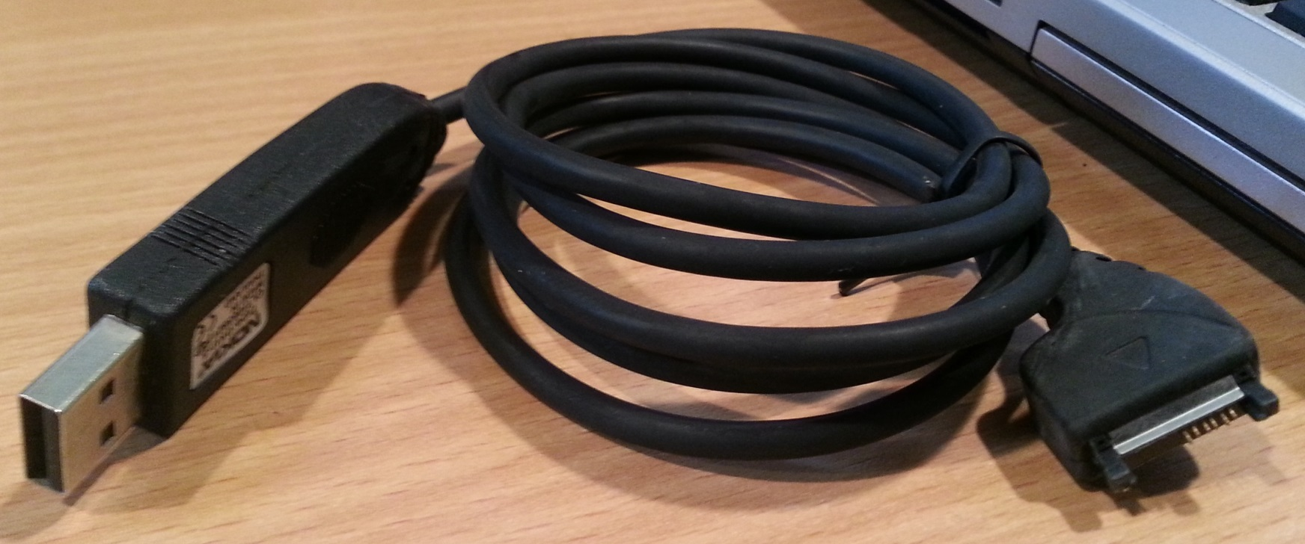
There’s firmware in my USB?
Even “simple” USB devices can have interesting complexity
As an example, here’s a sync cable for an older phone...

Slide 17
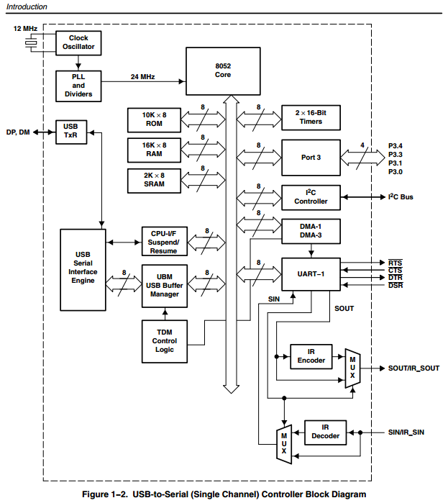
There’s firmware in my USB?
That contains a USB to UART bridge chip that looks like this internally...
8052 processor
10K Boot ROM
16K RAM
2K SRAM
Loads firmware from I²C
Notes:
From http://www.ti.com/lit/ds/symlink/tusb3410.pdf

Slide 18
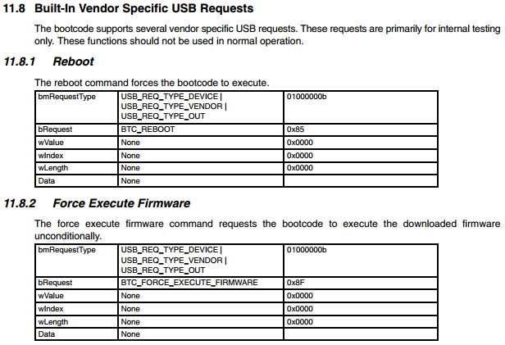
There’s firmware in my USB?
And the datasheet describes how to run your own code in it...
Arbitrary code execution inside your phone sync cable? Really?
Notes:
From http://www.ti.com/lit/ds/symlink/tusb3410.pdf

Slide 19
There’s firmware in my USB?
And the datasheet describes how to run your own code in it...
Arbitrary code execution inside your phone sync cable? Really?
Notes:
From http://www.ti.com/lit/ds/symlink/tusb3410.pdf
This usb controller is used in a wide range of different applications from this phone sync cable to multi-thousand-dollar network infrastructure devices.

Slide 20
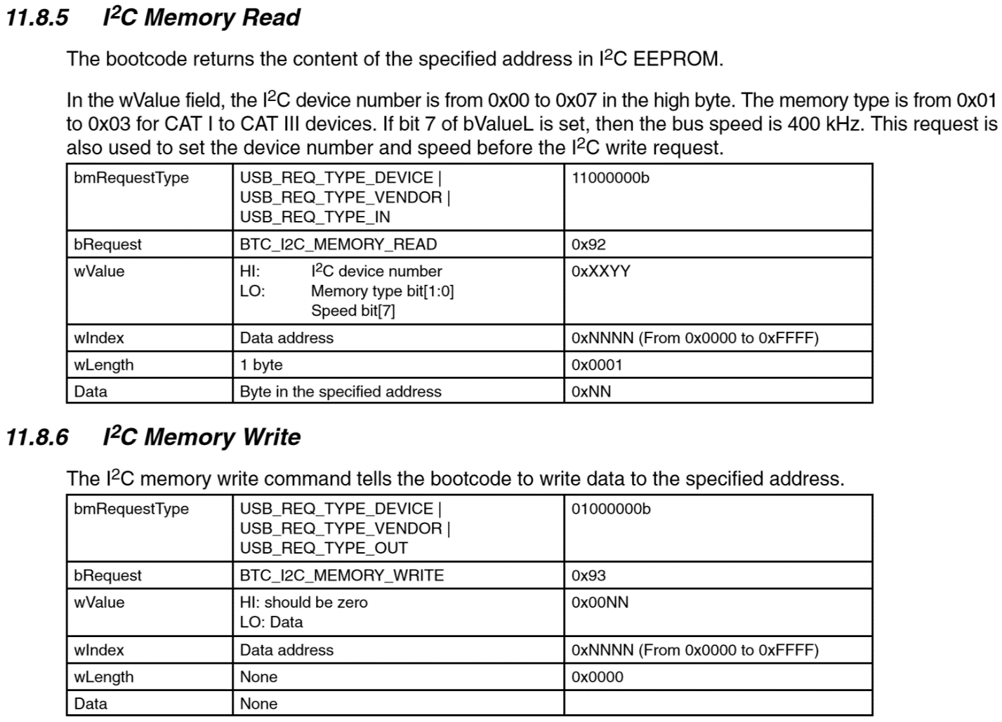
There’s firmware in my USB?
The datasheet also describes how to read and write to the I²C EEPROM it executes code from…
Notes:
Allows any payloads written to the device firmware to persist through reboots and power-downs.

Slide 21
Device Firmware Upgrade
http://www.usb.org/developers/devclass_docs/DFU_1.1.pdf
There’s actually a specification for how to create USB devices with upgradable firmware.
It doesn’t mention security at all. And most devices that implement this capability don’t bother to do any validation of the firmware image other than basic checksums which are easy to bypass.
DFU and similar custom device upgrade methods are a good way to easily get arbitrary code execution within a USB device.
What can we do with that?
Notes:
Original 1.0 version released in 1999 : http://www.usb.org/developers/devclass_docs/usbdfu10.pdf
Updated 1.1 version released in 2004: http://www.usb.org/developers/devclass_docs/DFU_1.1.pdf

Slide 22
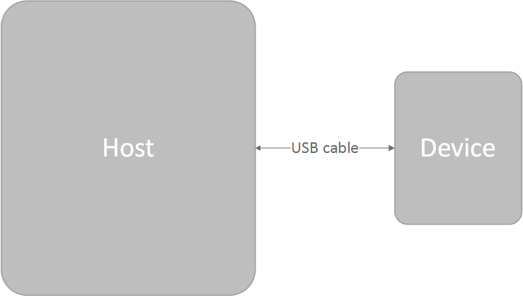
Attack Surfaces
So instead of looking at it like this...

Slide 23
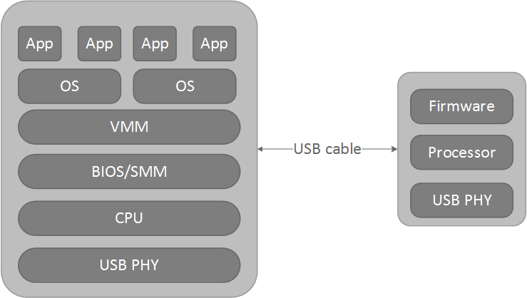
Attack Surfaces
There’s actually a lot more going on...

Slide 24
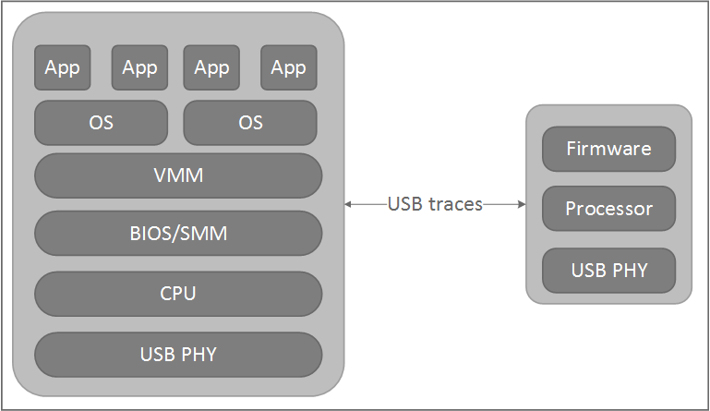
Attack Surfaces
All of this is probably happening inside your laptop right now.

Slide 25
Attack Surfaces
Some USB devices even have radio interfaces...

Slide 26
Attack Surfaces
If you can get arbitrary code execution within the USB device...

Slide 27
Attack Surfaces
It can be used to attack components within the host.

Slide 28
Attack Surfaces
Even with attacks originating from the host, these can cross privilege boundaries
Notes:
The firmware running in the controller we talked about earlier can arbitrarily change the USB VID and PID and USB device descriptors which are presented to the host. It can also force a reconnect in order to trigger re-enumeration in the host after these values have changed. Which is especially interesting when you consider USB devices passed down to virtualized guests. If you have malware running inside a virtualized guest that can write malicious firmware to a usb device whether it’s an external device or one soldered down to your motherboard, it could potentially change its VID/PID and trigger re-enumeration to show up as a completely different device in order to escape confinement and cross the privilege boundary from the guest to the host.
Jeff Forristal referred to this type of attack scenario in 2012 as a Hardware Involved Software Attack-- https://cansecwest.com/csw12/Forristal.pptx

Slide 29
Debug Capability
Allows low-level debug over USB
Now required to gain Windows Logo certification
“If the XHCI controller in the SUT has any user-accessible ports, the controller must have debug capability.”
Notes:
http://msdn.microsoft.com/en-us/library/windows/hardware/hh439372%28v=vs.85%29.aspx
Older EHCI version of Debug Capability required special hardware, but the XHCI version is better integrated into the protocol stack and works through standard usb hubs.

Slide 30
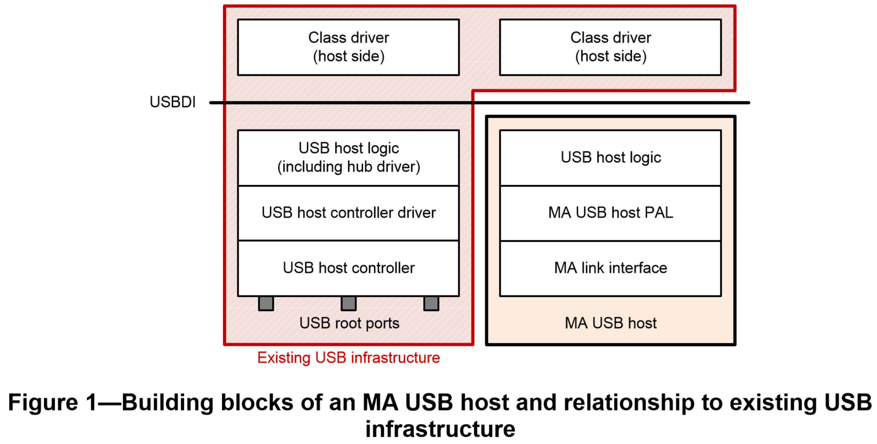
Media Agnostic USB
http://www.usb.org/developers/devclass_docs/Media_Agnostic_USB_v1.0.zip
Notes:
Initial 1.0 spec released in February 2014: http://www.usb.org/developers/devclass_docs/Media_Agnostic_USB_v1.0.zip
Basically swaps out everything to do with the physical layers and allows it to be replaced with another transport mechanism while still maintaining full USB endpoint functionality.

Slide 31
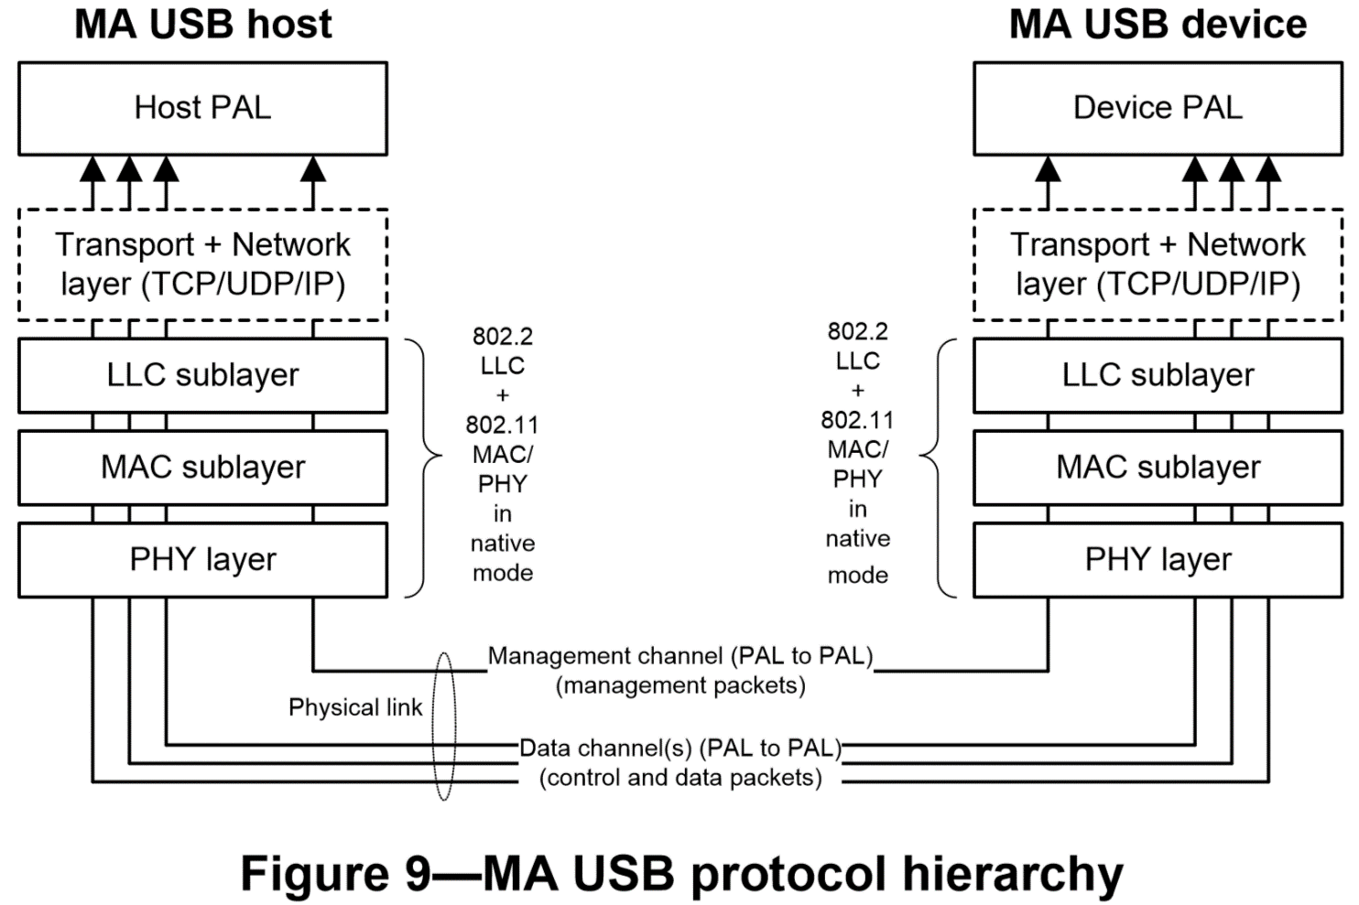
Media Agnostic USB
Notes:
Initial 1.0 spec released in February 2014: http://www.usb.org/developers/devclass_docs/Media_Agnostic_USB_v1.0.zip
Initial version of the spec describes using WiFi and WiGig as the transport mechanism.
We haven’t played with hardware for this yet, but we wanted to give you guys a heads up that this is on the way and should be a lot of fun to break.

Slide 32
Alternate Modes
Type-C connector supports non-USB alternate modes like PCIe.
Wait, what?
“The USB Billboard Device Class definition describes the methods used to communicate the Alternate Modes supported by a Device Container to a host system. … An example of a Device Container that shall support this class is one that supports PCIe over the USB Type-C connector.”
http://www.usb.org/developers/docs/devclass_docs/USB_Billboard.zip
Notes:
USB Power Delivery spec which is part of the USB 3.1 specification has more details about switching into alternate modes
All that stuff Joe talked about yesterday about PCIe attacks will be possible on some systems over the USB port also.

Slide 33
Tools!

Slide 34
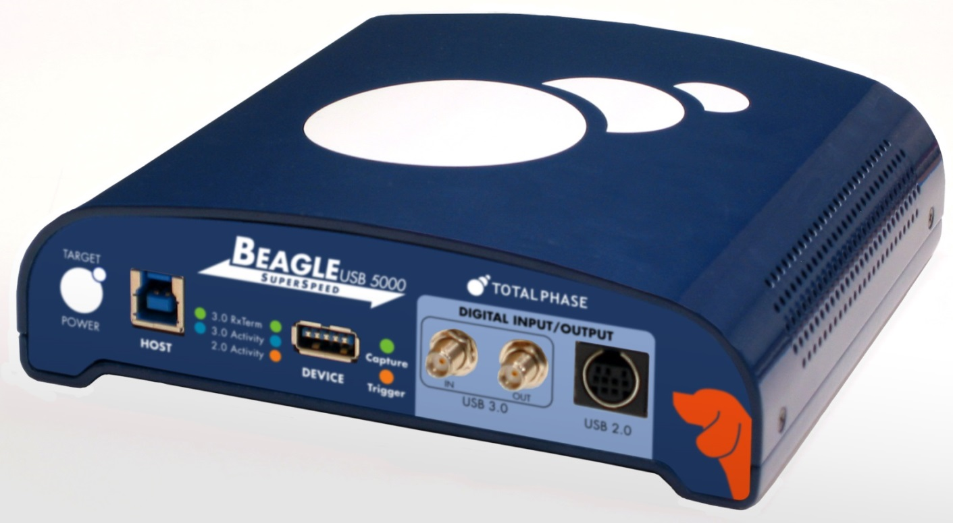
Total Phase Beagle 5000
http://www.totalphase.com/protocols/usb/
Supports USB 3.0 SuperSpeed, but very expensive. Can only be used for observation and not injection.

Slide 35
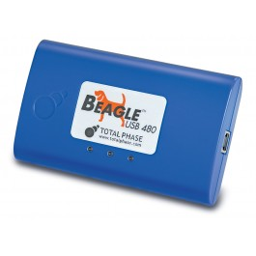
Total Phase Beagle 480
http://www.totalphase.com/protocols/usb/
Less expensive than Beagle 5000, but only supports USB 2.0. Can only be used for observation and not injection.

Slide 36
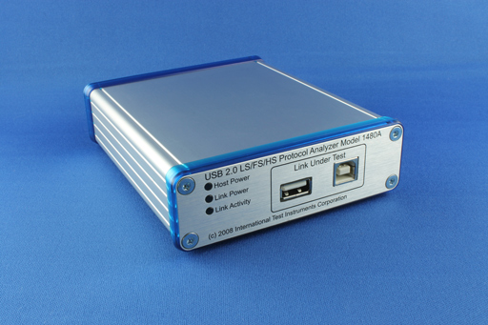
ITIC 1480A USB 2.0 Protocol Analyzer
http://www.internationaltestinstruments.com/products/97-1480a-usb-20-protocol-analyzer.aspx
HW less expensive than Beagle 480, but some SW modules sold separately. Can only be used for observation and not injection.

Slide 37
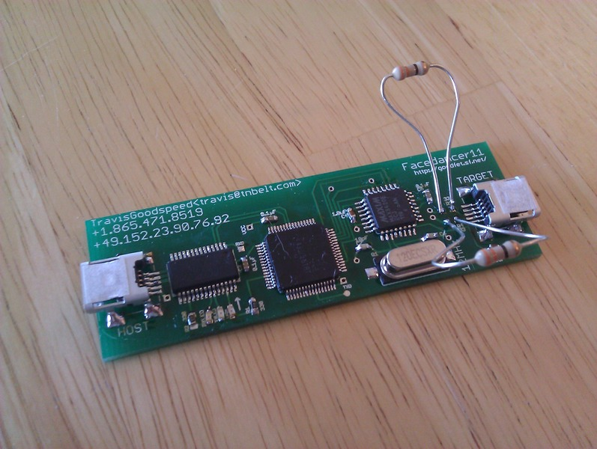
Facedancer
http://goodfet.sourceforge.net/
Open source, cheap and easy to build, allows arbitrary emulation of USB endpoints, but can be very slow
Notes:
Travis Goodspeed

Slide 38
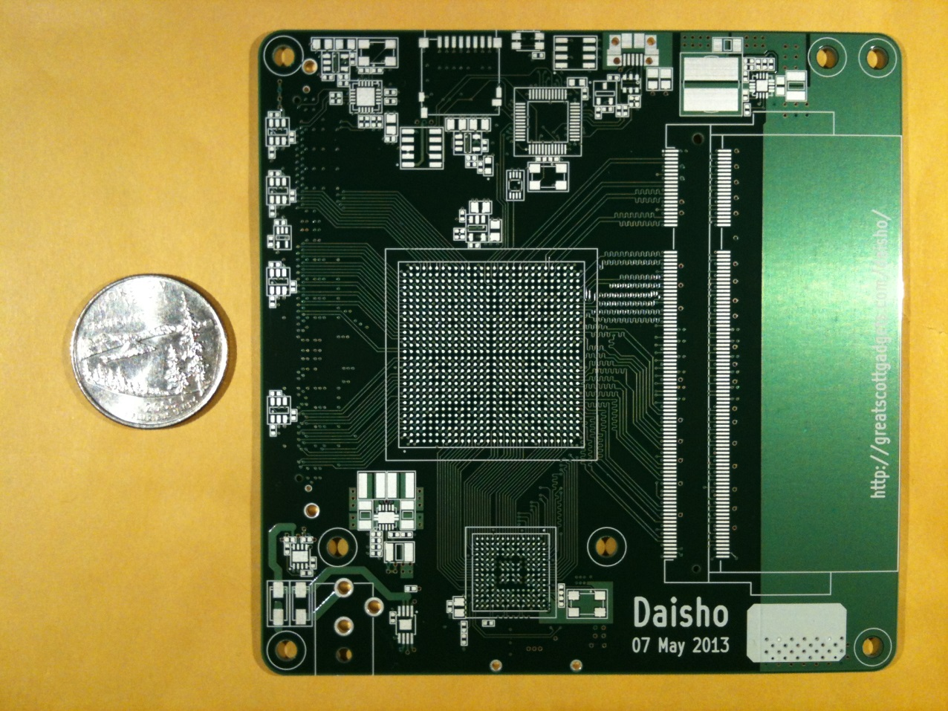
Daisho
https://github.com/mossmann/daisho
Open source, intended to support full USB 3.0 SuperSpeed monitoring and injection, but still in development
Notes:
Michael Ossmann, Dominic Spill, Marshall Hecht, Jared Boone, Mike Kershaw, Benjamin Vernoux

Slide 39
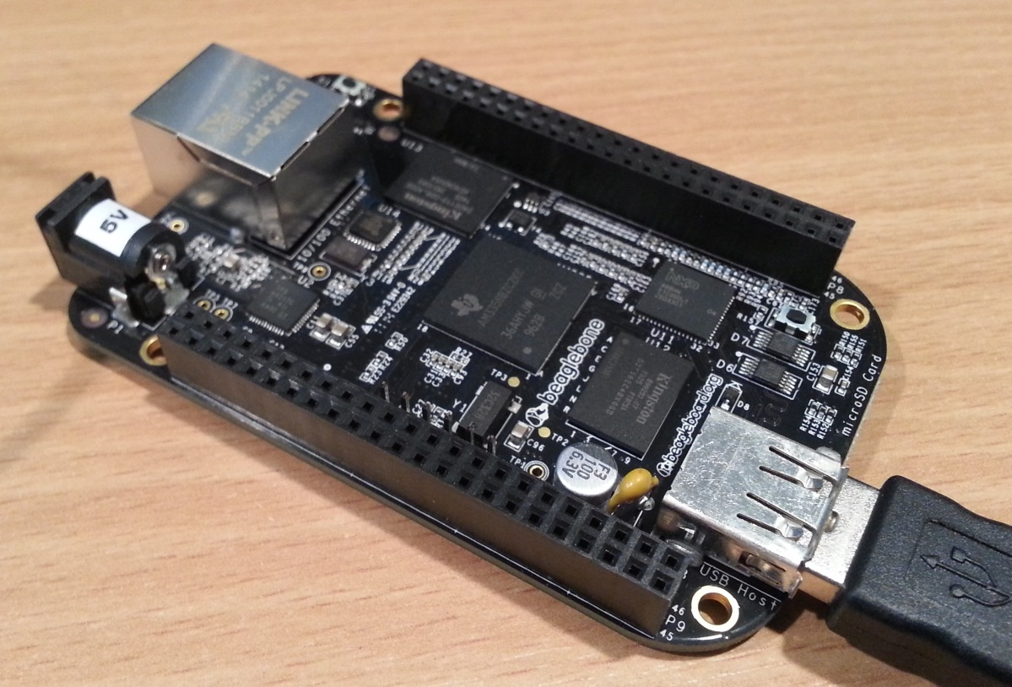
USBProxy
https://github.com/dominicgs/USBProxy
Open source project to create a USB 2.0 MitM device using the BeagleBone Black, still in early stages, but can already do some cool stuff
Notes:
Dominic Spill
Contributions welcome!

Slide 40
libusb
http://www.libusb.org/
Good way to get started with writing tools to access USB devices

Slide 41
Peach Publishers
Data Publisher
Configuration Publisher
This uses libUsbDotNet which hasn’t been maintained in a while, so it has its bugs, but has been useful for finding issues.
Submitted to Peach upstream
Notes:
Mickey Shkatov

Slide 42
umap
https://github.com/nccgroup/umap
USB host security assessment tool
Primarily implements a set of fuzzing test cases targeting host drivers
Built on top of the Facedancer hardware
Written in python
Notes:
Andy Davis at NCC Group
Test cases haven’t been updated in a year and the published examples are still crashing drivers in Windows 8.1

Slide 43
Phison PS2303 framework
https://bitbucket.org/flowswitch/phison/
Phison PS2303 is a USB 3.0 NAND controller used in many flash drives
8051-compatible core
256KiB ram
USB, NAND, and DMA controllers
Stores firmware in NAND
Goal of the project is to use PS2303-based flash drives as a cheap USB3.0 development platform
Notes:
This is the set of chips targeted by Karsten Nohl and Jakob Lell in their BadUSB talk and covers a large percentage of the USB device market

Slide 44
Kautilya toolkit
https://github.com/samratashok/Kautilya
Collection of 40+ USB HID payloads for penetration testing
Dump Process Memory
Dump Windows Vault Credentials
Download and Execute
Connect to Hotspot and Execute code
Code Execution using Powershell
Code Execution using DNS TXT queries
Add an admin user
Add a user and Enable RDP
Add a user and Enable Powershell Remoting
… and more
Designed to be used with Arduino devices like the Teensy, but easily adaptable to other devices like the Phison chipset

Slide 45
Psychson
https://github.com/adamcaudill/Psychson
Publically released parallel implementation of Phison chipset attack
complete 8051 firmware source
C# tools to interact with Phison-based flash drives
convert Rubber Ducky scripts into custom firmware
inject patches into existing firmware images
Authors believe nothing will be done to fix the problem unless tools released publically
Notes:
Adam Caudill and Brandon Wilson released at Derbycon last weekend

Slide 46
Demos!

Slide 47
Summary
USB is a pervasive technology in modern computing devices.
Not just external ports which require physical access to attack
Devices connected over USB run upgradable firmware
Debug capability required for Windows certification
Interesting attack scenarios with internal devices
USB provides a rich set of capabilities and is being used in a variety of configurations that could result in security vulnerabilities and it’s easier than people think to get started looking at this stuff.

Slide 48
Questions?
jesse at lonelyrhinoceros.com
laplinker at gmail.com

